Slide 1



Restaurant Promotional Event
Sean Youngseon Lee
Jeff Youngjae Lee
March 25, 2024

Slide 2


Table of Contents
01
About Us
02
Introduction
03
Data Analysis
04
Results
05
06
Reflection
Possible Confounding Variable

Slide 3
01
About Us

Slide 4
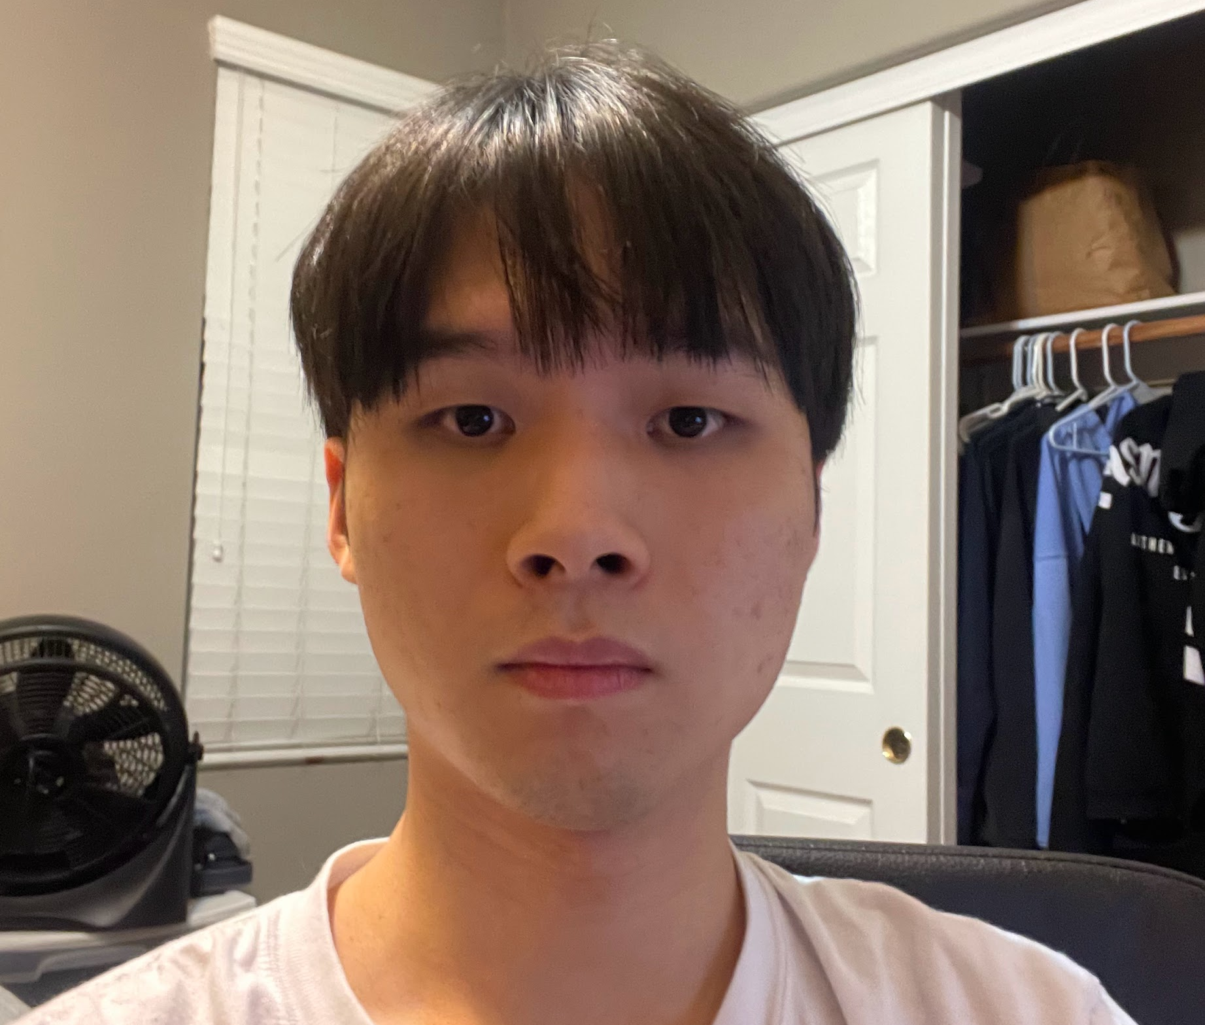
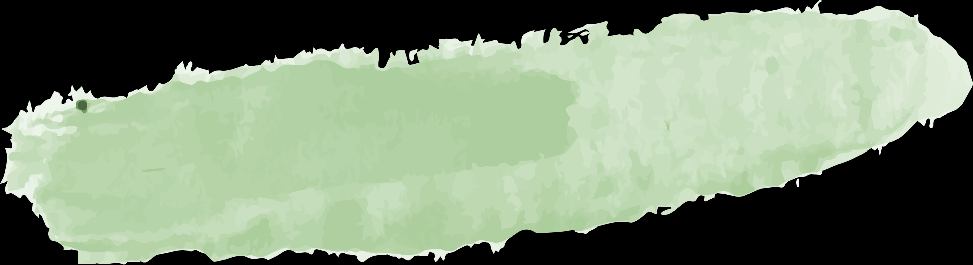



Sean Lee
UC Irvine - B.S. Data Science
Experience
Dr. Yoonjin Won’s Thermodynamics Lab (UCI) - Research Assistant
Engaged in the Hyundai Autonomous Vehicle Project to analyze degradation in cameras under extreme conditions
Analyzed thousands of images through MATLAB’s Statistics and Machine Learning Toolbox
Created pixel histograms to quantify noises in images after data extraction
Projects
Energy Usage Prediction in California - Accenture
Led a project sponsored by Accenture to predict the monthly energy consumption of California
Utilized seasonality of average gas price by state to predict the future energy consumption of California
Data wrangling, data processing, SARIMAX, LSTM, Decision Tree, Linear Regression
Submitted a paper to “Energy Exploration & Exploitation” which is currently under review
(949) - 390 - 4811
TensorFlow Certified Developer
LinkedIn.com/seanlee319
Github.com/seanlee319

Slide 5
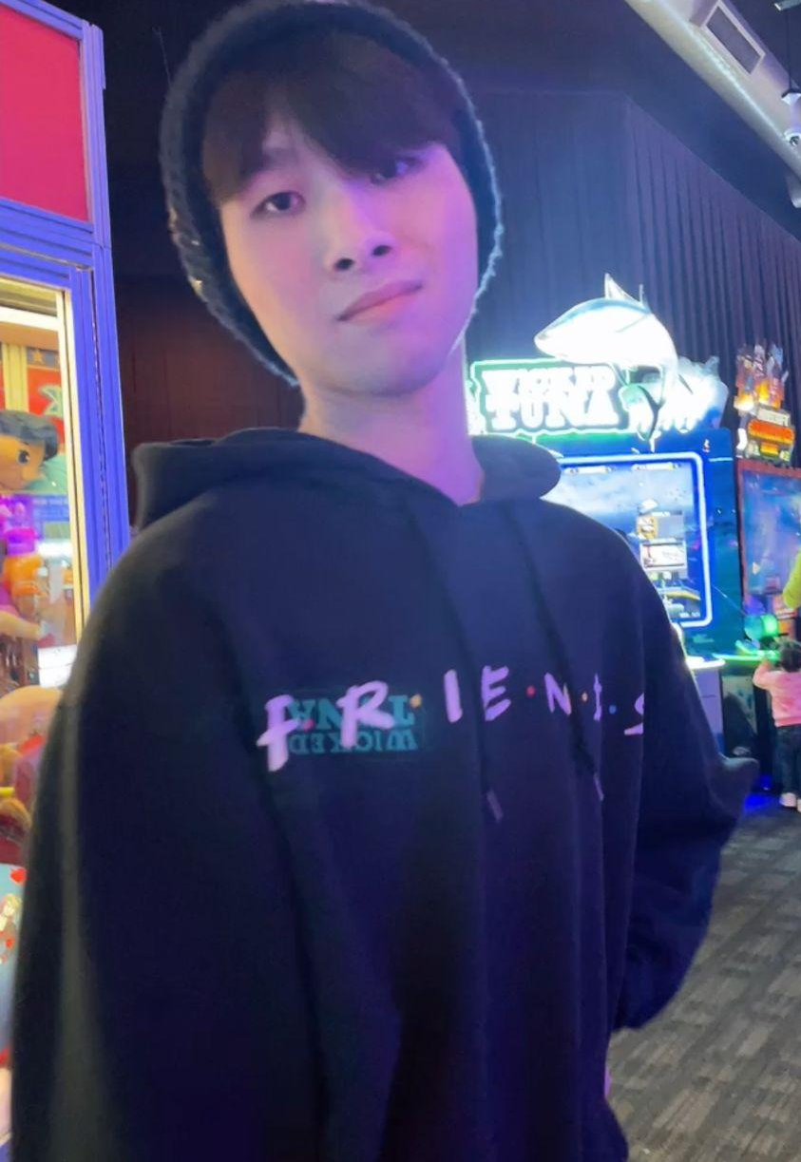
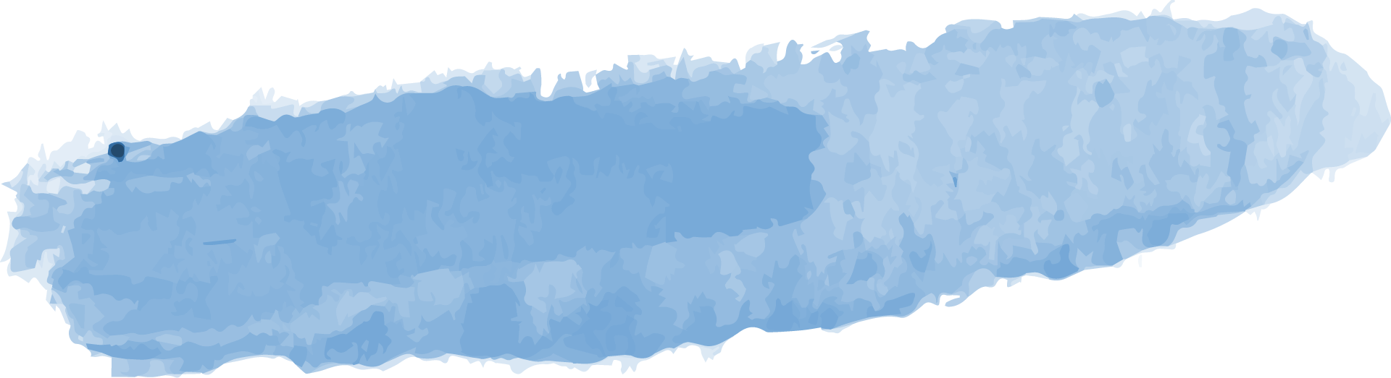
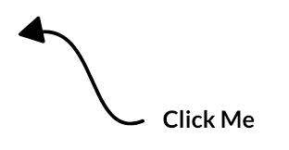

Jeff Lee
Vanderbilt University - B.A. Chemistry
Research Assistant @ Boston Children’s Hospital
Experience
Korbato-Health
Currently working under supervision of Dr. Ryuichiro Yagi and Dr. Shinichi Goto to develop ML models to analyze ECG signals to detect rare heart diseases such as Hypertrophic Cardiomyopathy
Projects
Jeff The Scientist | JeffTheScientist.vercel.app
Developed a personal portfolio website from scratch using HTML, TypeScript, Tailwind CSS, NextJS
Interactive Digit Recognizer |
Utilized TensorFlowJS and MNIST dataset to create an interactive webpage on which one can draw digits for the ML model to read
(949) - 390 - 4809
TensorFlow Certified Developer
JeffTheScientist.vercel.app
LinkedIn.com/jeffyoungjaelee
Github.com/leejeff0319

Slide 6
02
Introduction

Slide 7


Our Motivations
We needed a Data project for Portfolio:
Opportunity arose at Sean’s workplace
Owner was family friend
We wished to contribute while refining our expertise in data analytics/science
Pitched the idea of a Promotional Event:
Noodle orders come with a free beverage of choice (7/16 ~ 8/31)

Slide 8

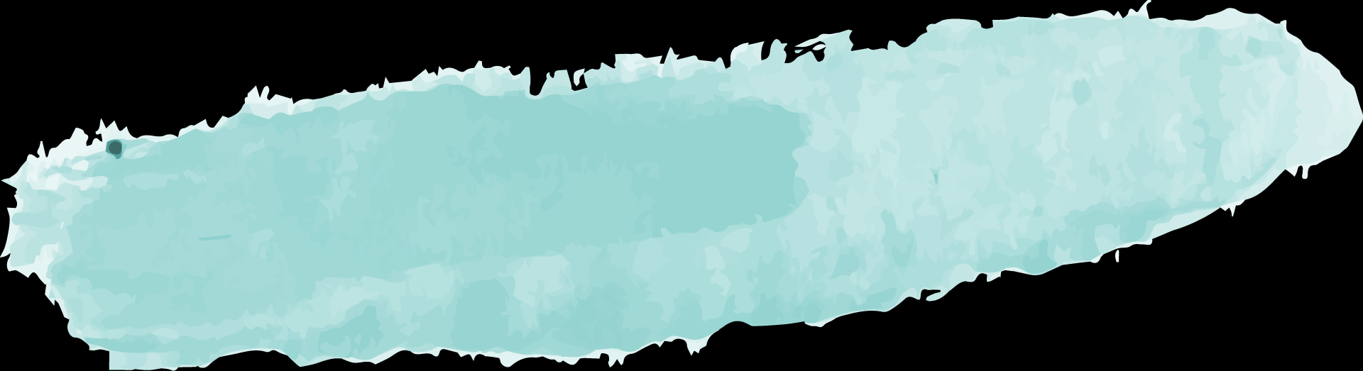
Goals
Goal 1
Goal 2
Goal 3
Increase noodle sales by 50% during event period
Increase net sales by 15% during event period
Retain noodle sales after the event period

Slide 9
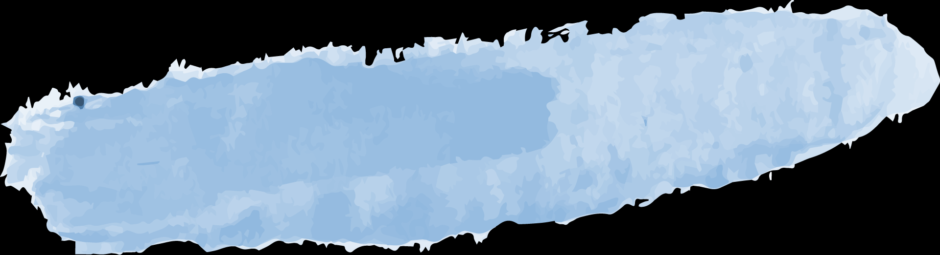
Timeline
May 2023
July 2023
Jan 2024
Start of dataset
Promotional Event begins
End of dataset
June 2023
August 2023
Proposed the idea to restaurant owner
End of Promotional Event

Slide 10
03
Data Analysis

Slide 11
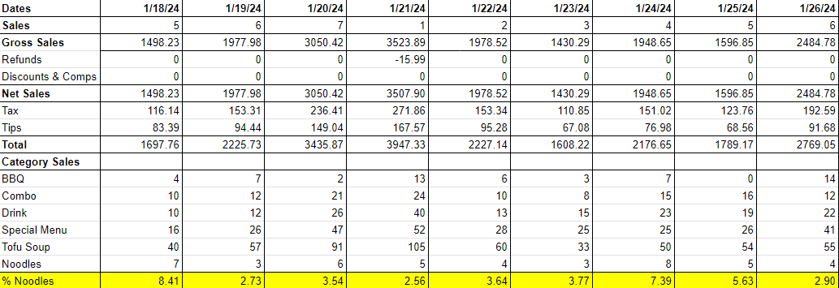
Dataset
Granted permission to use sales data
But only generalized data, not the comprehensive dataset
Privacy/security reasons
Fig 1. Snapshot of the data used for analysis

Slide 12
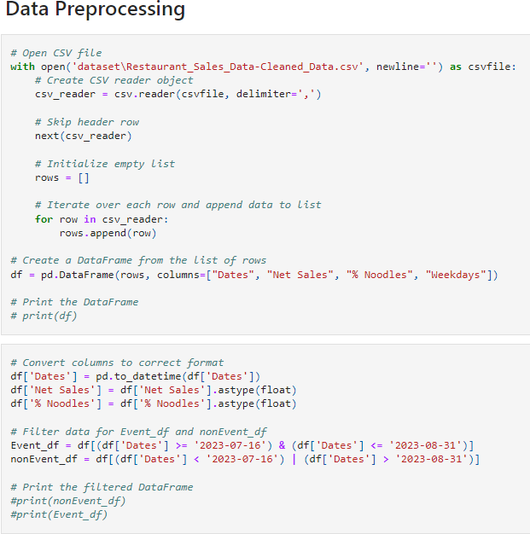
Analysis
Duration
Data Collection- 8 mo
Data Analysis- 2 days
Approach
Analyzed/organized dataset using Excel & SQL
Preprocessed data using Python
859
1000
Stakeholders
541
Restaurant Owner
Manager

Slide 13
04
Results

Slide 14
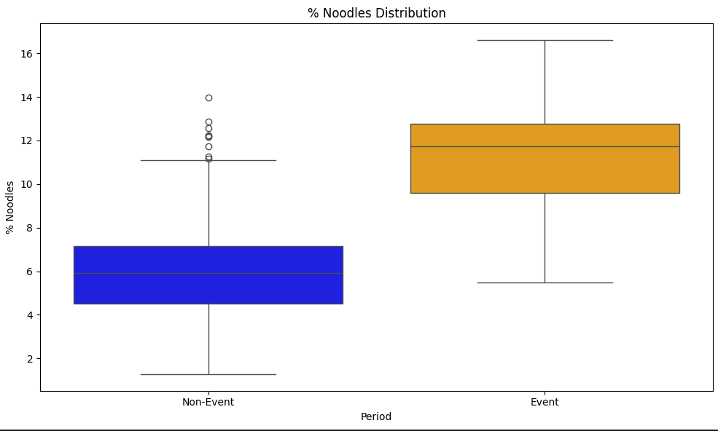
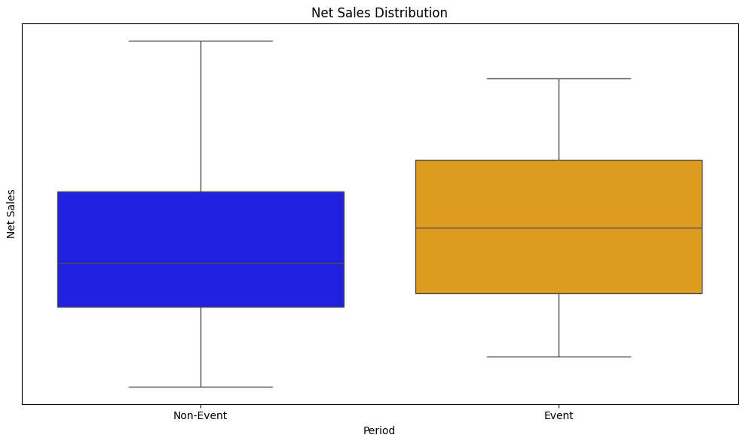
Results
Business Impact
81.13% increase in Noodle Sales
7.18% increase in Net Sales
Significant increase in Noodle Sales had little to no effect on Net Sales
Customers ordered noodles instead of tofu or other alternative entrees, which are similar prices
Fig 2. Bar graph of % Noodles during Non-event period vs. Event period
Fig 3. Bar graph of Net Sales (in $) during Non-event period vs. Event period. Actual numbers are omitted for privacy reasons

Slide 15
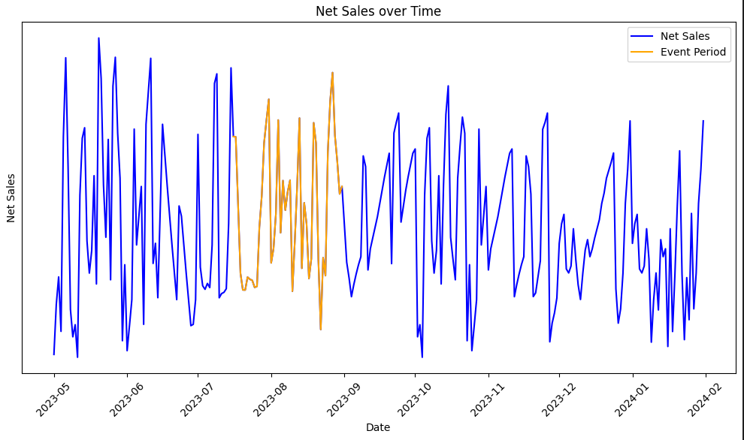
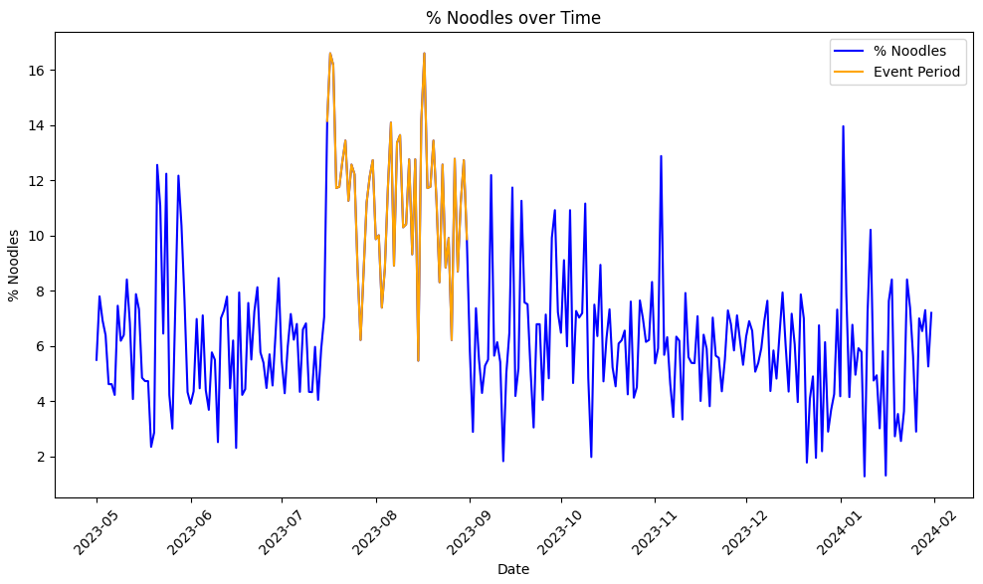
Results
Little to no visual difference in Net Sales during the event period
Noticeable increase in % Noodles during the event period
Fig 4. Graph of net sales (in $) over recorded time period. Highlighted region represents period of promotional event. Actual numbers are omitted for privacy reasons.
Fig 5. Graph represents the % of net sales that are composed of noodles.

Slide 16
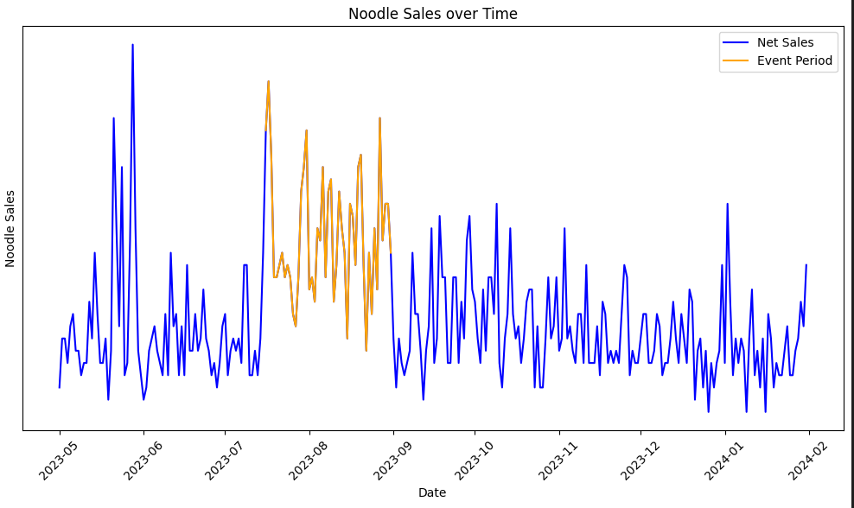
Results
More number of noodles sold during promotion on average
Shows a similar trend with % Noodles over Time graph
Fig 6. Graph represents the total numbers of noodles sold each day over recorded time period.

Slide 17
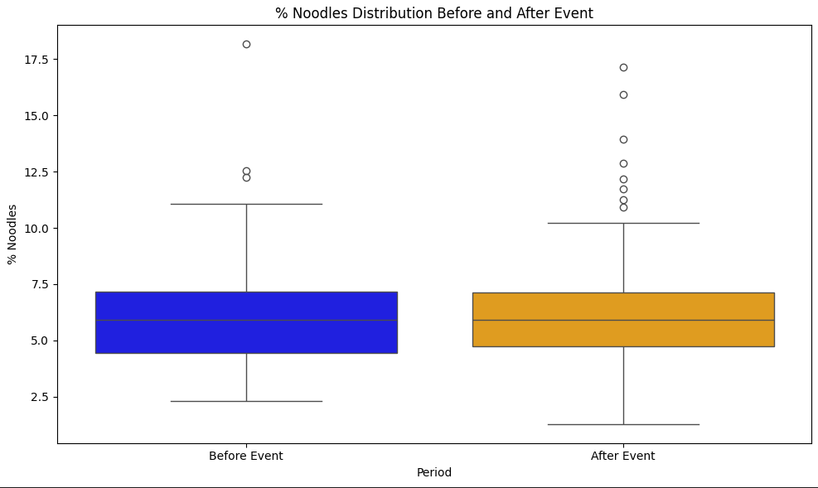
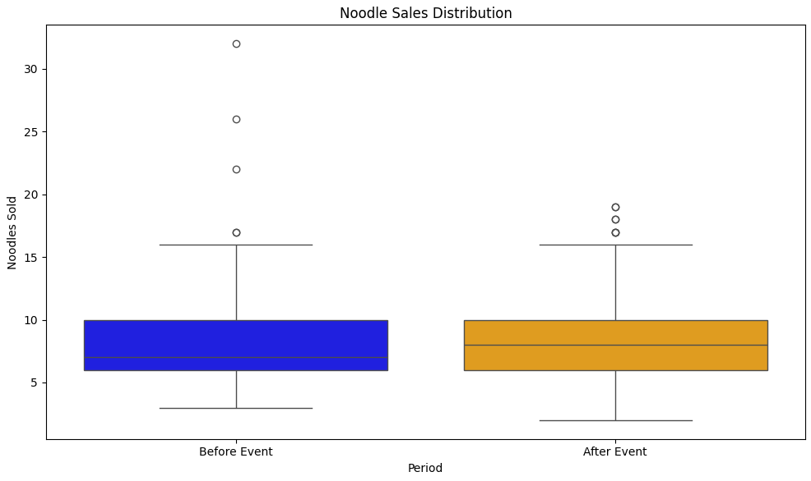
Results
Little to no difference in % Noodle distribution and Noodle Sales after the event when compared to before the event
Outliers present
Fig 7. Bar graph of % of net sales composed by noodles before and after the promotional event. Used to evaluate noodle sale retention, or long-lasting effects of promotional event.
Fig 8. Bar graph shows average number of noodle sales per day before and after event. Also used to evaluate noodle sale retention, or long-lasting effects of promotional event.

Slide 18
05
Possible Confounding Variable

Slide 19
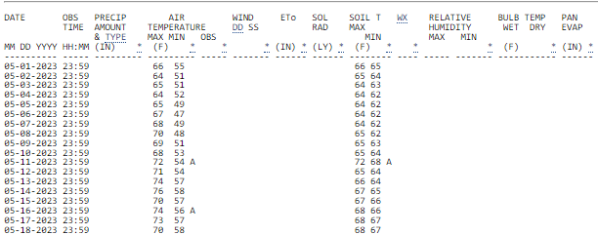
Possible Confounding Variable
Considered confounding variables that could have affected the results
Such as temperature
Fig 9. Public dataset of temperatures in the area from https://ipm.ucanr.edu/.

Slide 20
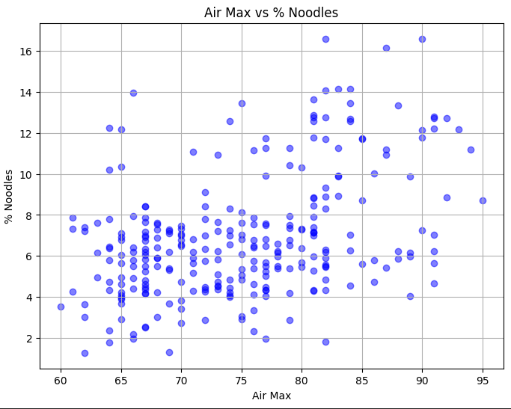
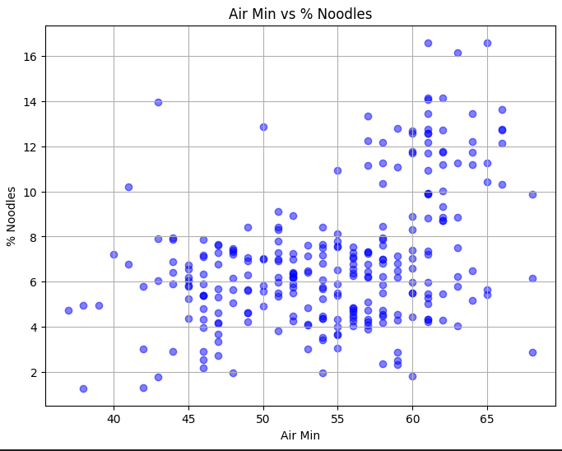
Possible Confounding Variable
Higher average max air temperature resulted in higher % noodle sales
Difficult to state the increase in the % noodle sales were solely due to the the promotion
Fig 10. Scatter plot of the highest temperature measured at 1.5 meters vs. % net sales composed of noodles.
Fig 11. Scatter plot of the lowest temperature measured at 1.5 meters vs. % net sales composed of noodles.

Slide 21
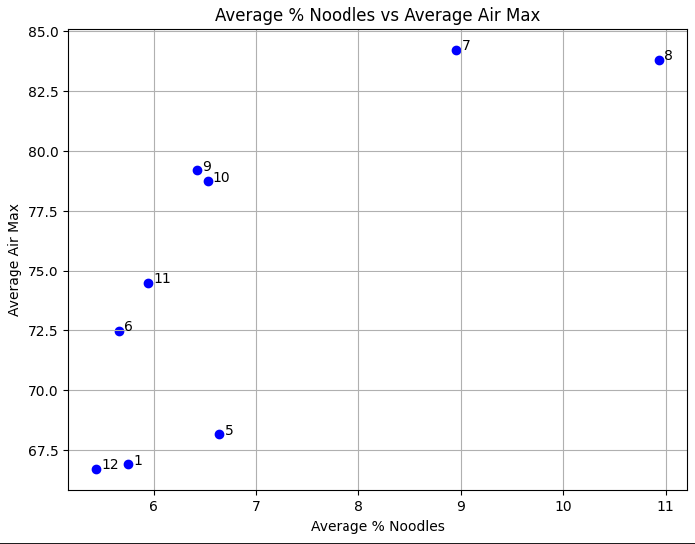
Possible Confounding Variable
Higher average max air temperature resulted in higher % noodle sales
Difficult to state the increase in the % noodle sales were solely due to the the promotion
Fig 12. Scatter plot of the average highest temperature measured at 1.5 meters for each month vs. % net sales composed of noodles.

Slide 22
06
Reflection

Slide 23
Goals
Goal 1
Goal 2
Goal 3
Increase noodle sales by 50% during event period
Increase net sales by 15% during event period
Retain noodle sales after the event period

Slide 24
Goals Reflection
Goal 2
Goal 1
Goal 3
✗
✓
Increased noodle sales by 81.13% during event period (Figs. 2, 5, 6)
Increased net sales by 7.18% during event period (Figs. 3 & 4)
✗
Unsuccessful retention of noodle sales after the event period (Figs. 7 & 8)

Slide 25
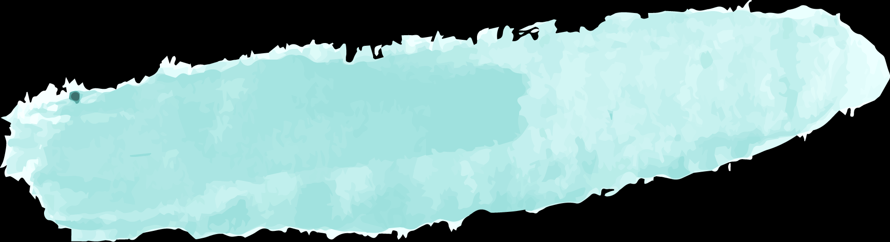
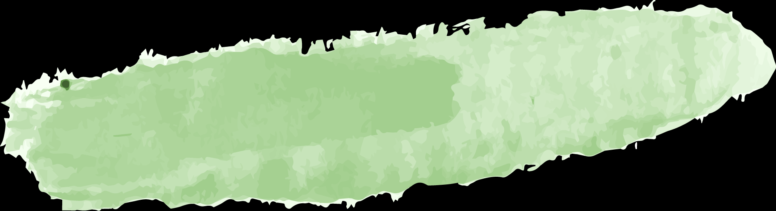
Reflection
Strengths
Weaknesses
Areas of Improvement
Feedback from Stakeholders
Proactive & Initiative
Always looking to apply data in everyday life
Noticeable increase of noodle sales during event
Percent Noodles over time graph (Figure )
Inconclusive Results
Within error bars
Dataset Limitation
Incomplete dataset (only 8 months)
Confounding Variables
Design Flaw
More & diverse data
From different years, seasons, etc.
Differentiate items within item category
More detailed visualization using Tableau
We used Seaborn
Include number of orders/day
Compare number of customers on days of event
Customer Retention (Returning & New)
Not provided for us on this dataset
Insightful analysis
despite limitations of given dataset
Positive effect in noodle sales

Slide 26
THANK YOU
Do you have any questions?

